Slide 1
Hypnotic Conflict Resolution: Is that a thing?
Dr. M. Paula Daoust
ICBCH Winter Conference

Slide 2
No surprise!
Of course, it is!

Slide 3
Who wants this?
The thing is NOT the thing!

Slide 4
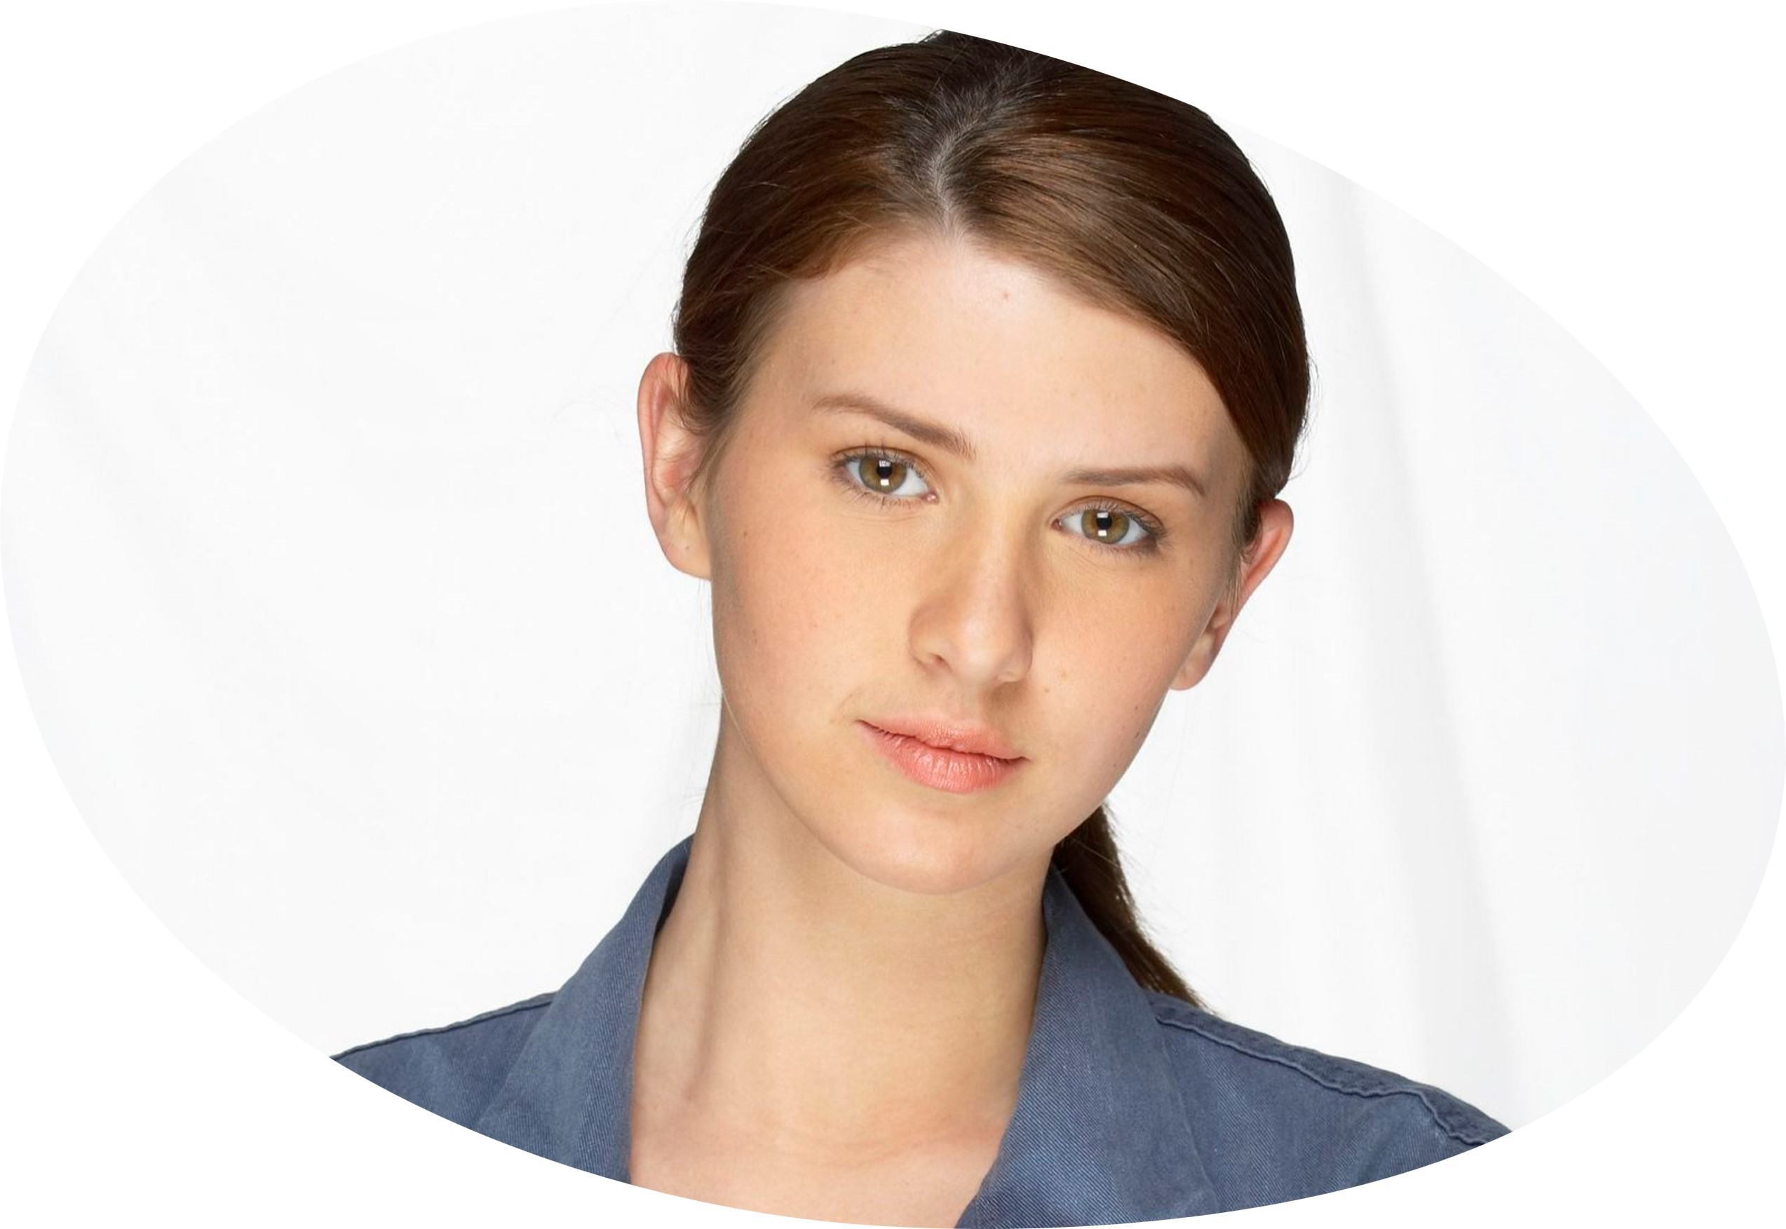
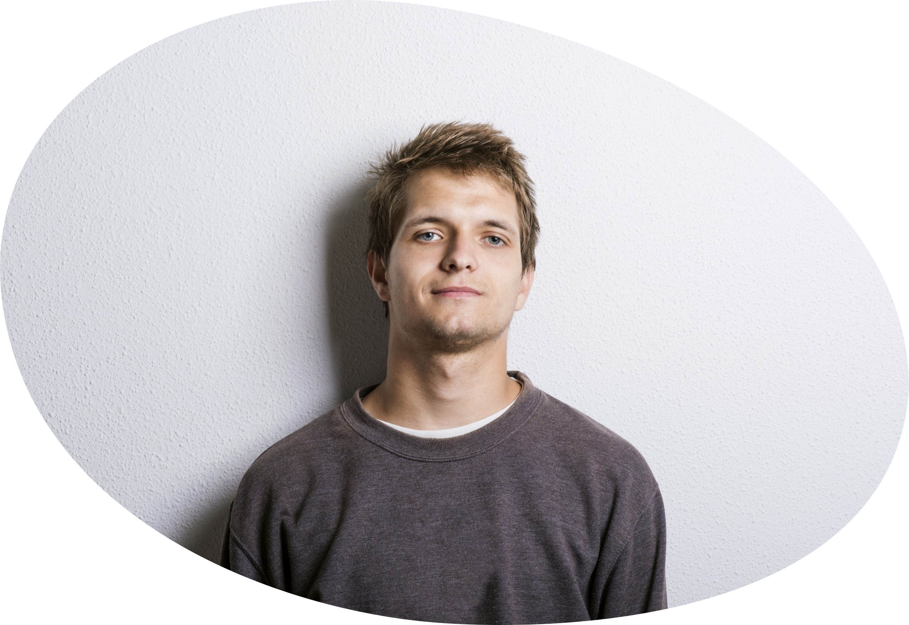
Janine
Eli
Maria

Slide 5
Psychological concept: Elegance
precision, neatness, and simplicity

Slide 6
But …

Slide 7
Conflict = Trance
Threat
Thalamus
By-passes
Prefrontal
Cortex –
the
Thinking
Brain
Amygdala
RAS

Slide 8
Conflict = Trance
Stress Response
Fight / Flight / Freeze

Slide 9
Two most common trances:
White Knight Club
Valiant Warrior
Martyr Syndrome
Right
Fighter

Slide 10
How do you know?
Describe a situation in which [ ]
was not present.
Outcome Specification
Describe a situation in which [ ]
was present.

Slide 11
Presenting problem
Past, current,
future conflicts

Slide 12
Behavior Momentum

Slide 13
Janine
Nail-biting
Boss picks on me

Slide 14
Eli
Focus and concentration
Demeaned by team member

Slide 15
Weight-loss
Fire-fighter husband taking risks
Maria

Slide 16
Never waste a trance
Re-direct it!

Slide 17
Because…
Behavior
Event / Facts
Feeling: Good or Bad
Consequence
A-B-C-D
Behavior Cycle
Take Action
Do

Slide 18
If you can change the because,
you can change the outcome.

Slide 19
Because she doesn’t care about the rules
Behavior
Jill is late to work
Annoyed
Antecedent
Consequence
A-B-C-D
Behavior Cycle
Reprimand Jill
Do

Slide 20
Because… she has a sick child
Behavior
Jill is late to work
Empathy
Antecedent
Consequence
A-B-C-D
Behavior Cycle
Ask if you can help.
Do

Slide 21
See, hear,
or measure
Two people would report the same
What happened
The “truth”
Verifiable
Evidence-based

Slide 22
Getting the facts:
Regression
Movie theater
Other tools?

Slide 23
Facts:
Called me into his office 3x’s last week.
Stopped by my desk to check in on my progress on a project every day this week
Lots of questions about my approach on the project
Gave a high-profile project to a colleague instead of me
Disagreed with my recommendations on the last project and he re-wrote the conclusions
Janine

Slide 24
Facts:
Team meeting to brainstorm strategies.
Team-mate interrupted him
Team-mate frowns when he offers another suggestion
Team-mate questions his idea and says, “we tried that already and it didn’t work.”
Team-mate reminds him during meeting that his part of the project is behind
Eli

Slide 25
Facts:
Spouse was injured on the job.
Spouse is in his 40’s and is having more difficulty meeting physical standards.
Spouse has refused and administrative position.
Grazes unhealthy foods when spouse is on 24-hour shifts.
Works longer hours and picks up fast-food when spouse is at work.
Maria

Slide 26
I wonder …
The current because;
1 ugly alternative because;
2-3 kind / sympathetic alternative because statements

Slide 27
Because:
Boss doesn’t trust that I can do the job and he picks on me so that I will quit.
Boss thinks he is smarter than everyone else and doesn’t really know is involved in the project.
Boss wants me to be successful and is coaching me.
Boss is under pressure from his supervisor and is anxious that the project is successful.
Boss can see that I am overloaded and concerned that the volume of work is interfering with the quality of my work.
Janine

Slide 28
Because:
Co-worker thinks he is smarter than me and enjoys making me look stupid.
Co-worker to impress management so he can get promoted.
Co-worker cares deeply about finding a good strategy.
Co-worker is concentrating on his own thoughts and is unaware of his non-verbals.
Co-worker has a lot on his desk and is impatient with the brainstorming process.
Eli

Slide 29
Because:
Spouse enjoys taking risks and doesn’t care what might happen to his family.
Spouse thinks he is invincible and can overcome anything.
The administrative position is less money, and he is worried about the family finances.
He wants to set an example for his sons – you don’t take the easy way out.
Maria won’t see him as the strong, courageous man she married if he takes a desk job.
Maria

Slide 30
CLEAN/N Conversation
Can we talk?
List the facts
Explain your because
Ask for the other’s because
Neutralize emotions / Next steps

Slide 31
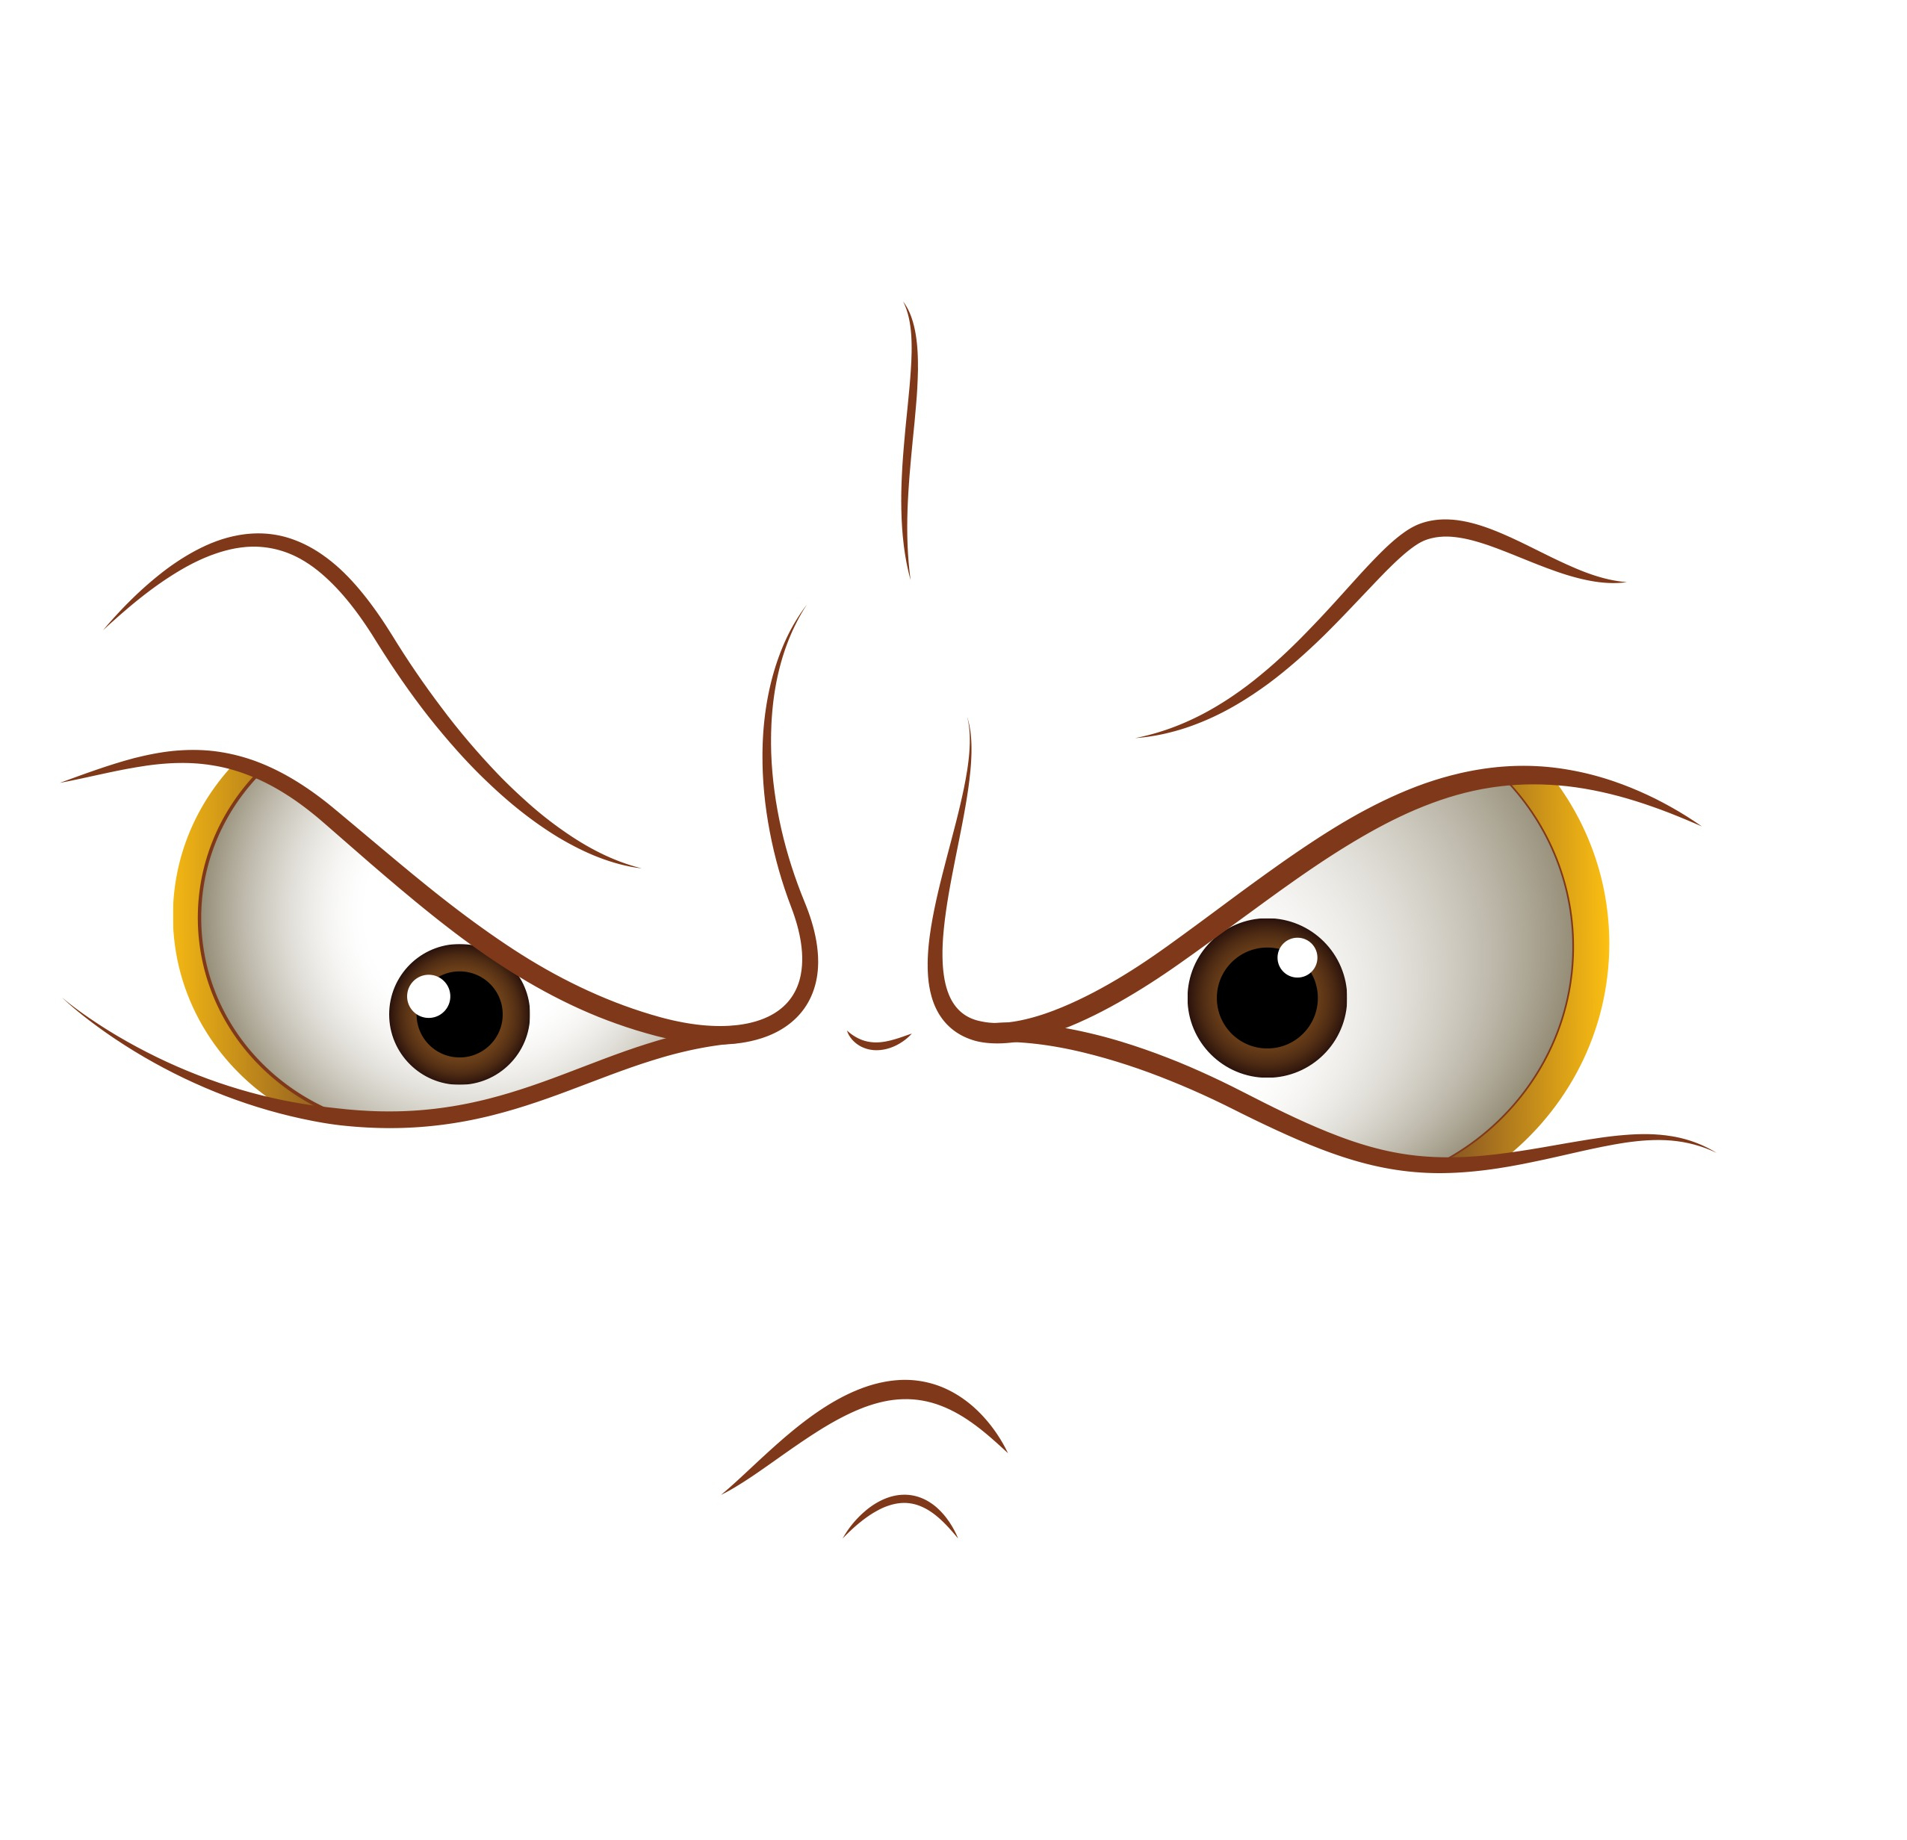
You cannot reason with a person who is highjacked!

Slide 32
Stop talking about the issue.
Neutralize emotions.
Return to the issue.

Slide 33
Use C.A.S.H. for safety
Clarify
Apologize
Show you care
Highlight shared purpose/goal.

Slide 34
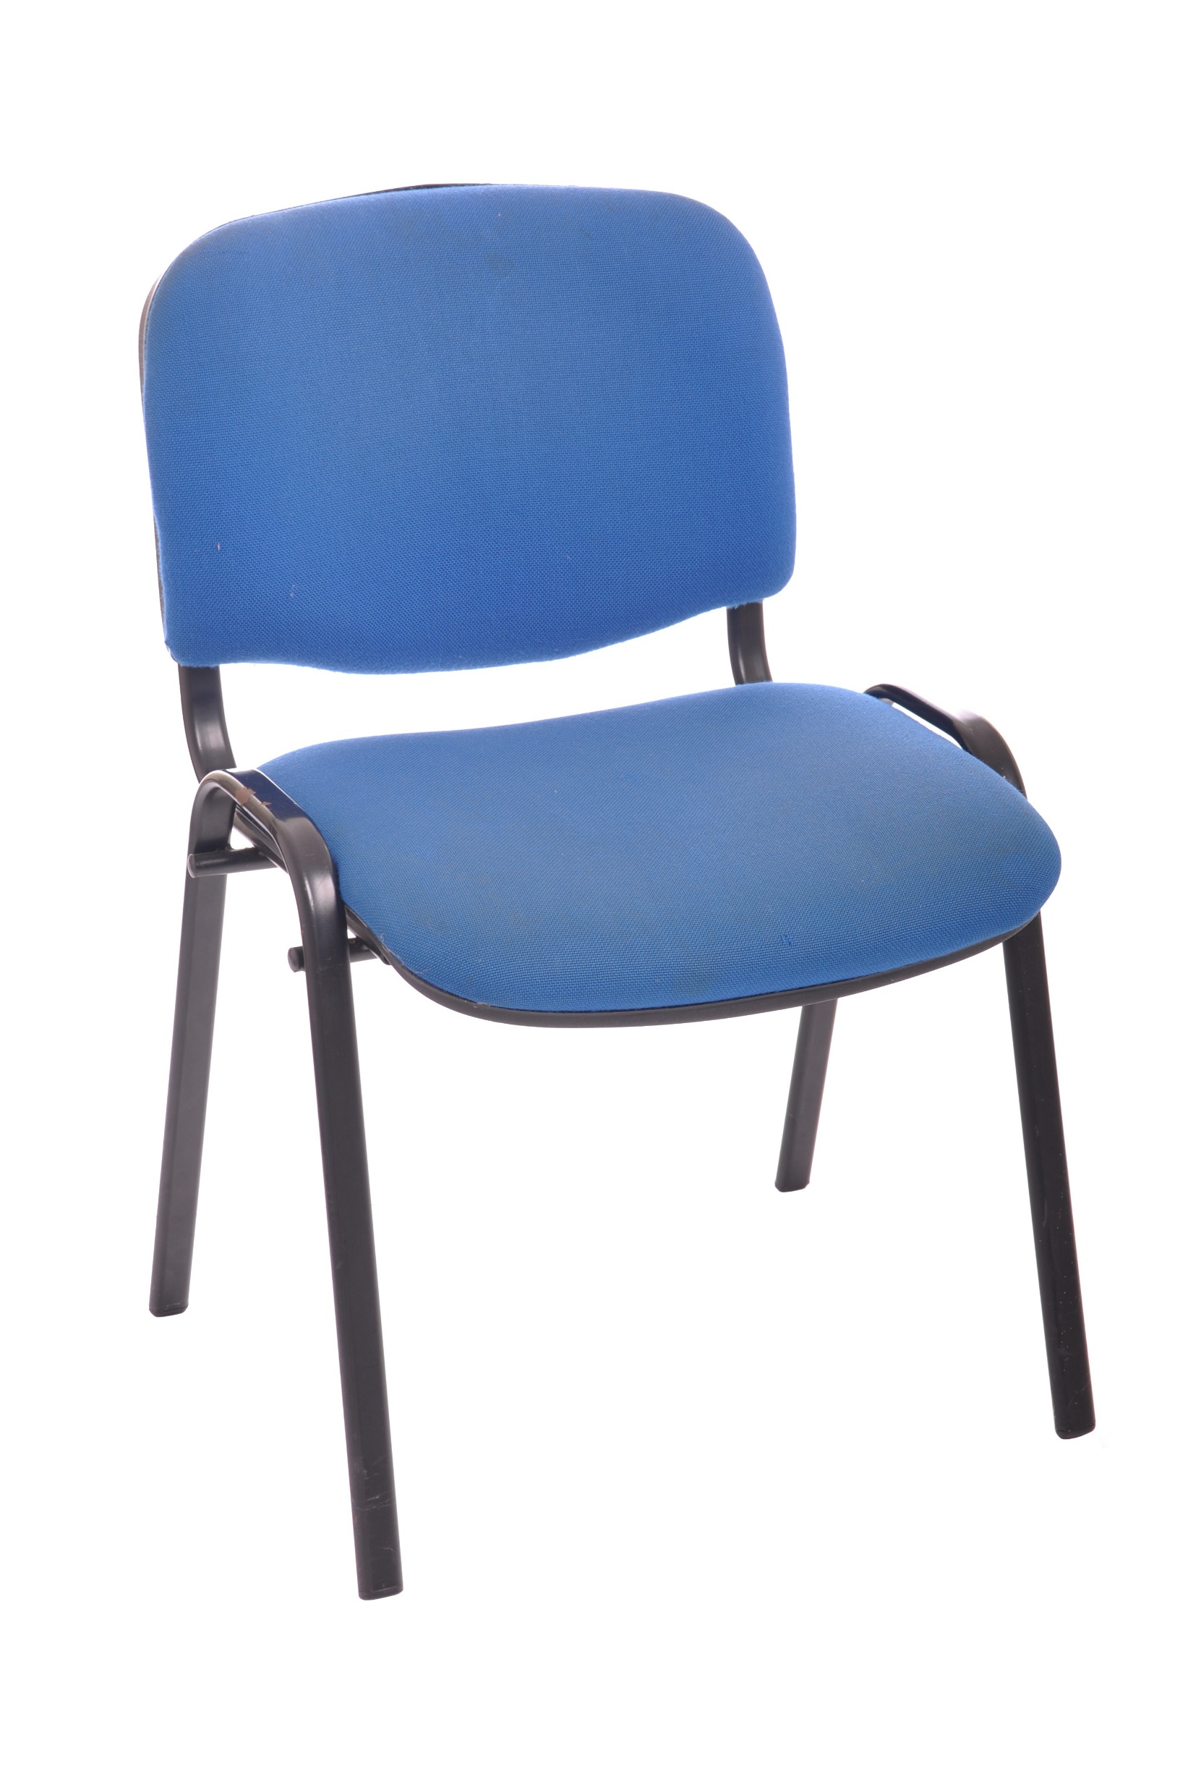
The empty chair technique:

Slide 35
Hypnotic Script for Conflict Resolution

Slide 36
Talk!

Slide 37
The rest of the story…
Boss was indeed being hard on her because he saw potential in Janine and was pushing her out of her comfort zone to help her develop.
Nail-biting disappeared at work.
Eli’s teammate didn’t realize the impact he was having on Eli. He apologized and toned down his behavior during meetings.
Eli’s supervisor noticed his increased participation in meetings.
Maria and husband worked out a plan for moving to a less risky position.
One year later, Maria had lost 30 lbs.

Slide 38
Give your clients what
they ask for
but,
if they get stuck,
deal with the
underlying conflict.

Slide 39
Handouts:
Slides
CASH and CLEAN/N Job Aids
Conflict Resolution Hypnotic Script
Available at:
Conflict Resolution Recording
www.behaviortransitions.com/ICBCH_2022

